Slide 1
Employee Attrition Analysis
By upputholla soujanyasri

Slide 2
Introduction
Employee attrition is a critical challenge for organizations, affecting operational continuity, employee morale, and overall productivity. Understanding the factors that contribute to employee turnover is essential for developing effective retention strategies. The Employee Attrition Analysis Dashboard provides a comprehensive overview of the attrition patterns within the company, offering valuable insights into various metrics and trends that influence employee departures.

Slide 3
>This dashboard is designed to help stakeholders and HR professionals visualize and analyze key aspects of employee attrition. By leveraging data driven insights, the dashboard enables the identification of high-risk areas, facilitates better understanding of workforce dynamics, and supports strategic decision-making to enhance employee retention.

Slide 4
Problem statement XYZ company which was established a few years back is facing around a 15% attrition rate for a couple of years. And it's majorly affecting the company in many aspects. In order to understand why employees are leaving the company and reduce the attrition rate XYZ company has approached an HR analytics consultancy for analyzing the data they have. You are playing the HR analyst role in this project and building a dashboard which can help the organization in making data-driven decisions

Slide 5
STEPS TO START THE EMPLOYEE ATTRITION ANALYSIS DASHBOARD
Gather relevant data on employee demographics, job roles, departments, tenure, satisfaction levels, and attrition status.
Clean the data to ensure accuracy and consistency, addressing any missing or erroneous values.
Select data visualization tools such as Power BI, Tableau, or Excel that suit your needs and expertise.
Plan the layout and key metrics to be displayed.
Ensure the design is user-friendly and interactive, with filters for department, gender, and marital status.
Calculate key performance indicators (KPIs) such as attrition rate, average age, and average tenure.
Add filters to allow users to segment data by department, gender, and marital status.
Ensure the dashboard responds dynamically to user inputs.
Verify the accuracy of the data and calculations.
Test the dashboard with different scenarios to ensure it functions as expected.

Slide 6
KEY METRICS
Overall Employee Count (4410): Indicates the total number of employees within the company.
Average Age (36.92 years): Reflects the average age of the employees.
Attrition Rate (16.12%): Shows the percentage of employees who have left the company.
Average Years in Company (7.01 years): Represents the average tenure of employees in the company

Slide 7
ANALYSIS
Attrition Rate by Education Field:
• Visualizes the number of employees who left the company based on their educational background.
• Highlights that employees from Life Sciences and Medical fields exhibit higher attrition rates.
Attrition Rate by Department:
• A pie chart illustrating the proportion of attrition across various departments.
• Indicates that Research & Development has the highest attrition rate, followed by Sales and Human Resources.
Attrition Rate by Years at Company:
• A line chart showing the number of employees who left the company categorized by their tenure.
• Reveals that attrition is higher among employees in their early years at the company.
Number of Employees by Age Group and Gender:
• A stacked bar chart depicting the distribution of employees across different age groups and genders.
• Shows that most employees are in the 26-35 and 36-45 age groups, with a relatively balanced gender distribution.
Attrition Rate by Job Role:
• A table listing different job roles with the number of employees categorized by job satisfaction levels (1 to 4 and NA). EMPLOYEE ATTRITION ANALYSIS DASHBOAR

Slide 8
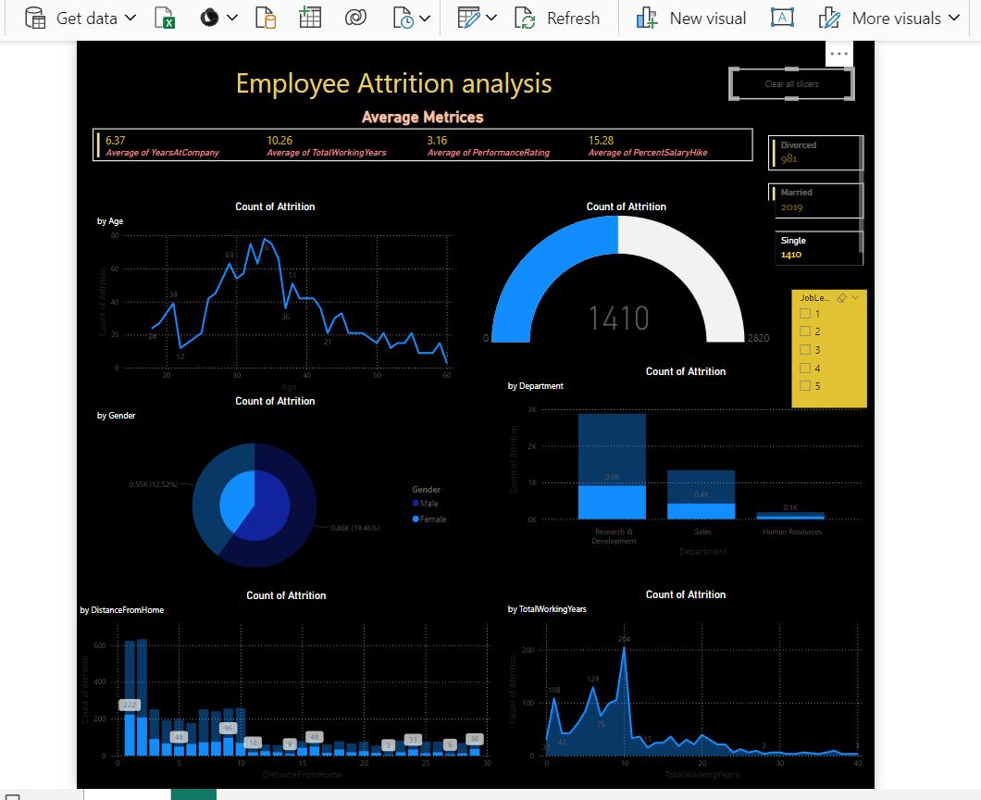

Slide 9
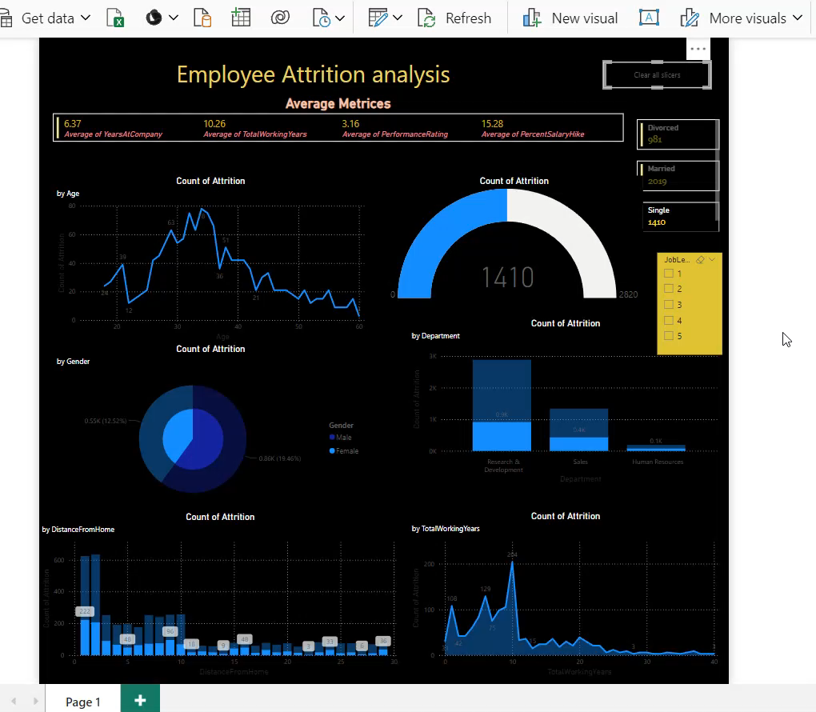

Slide 10
CONCLUSION
The Employee Attrition Analysis Dashboard is an essential tool for
understanding and addressing employee turnover. By providing data
driven insights, it helps stakeholders improve retention strategies,
enhance employee satisfaction, and maintain operational efficiency.
This dashboard identifies high-risk areas, supports strategic planning,
and fosters a positive work environment, enabling organizations to
build a more stable and productive workforce

Slide 11

THANK YOU

